Slide 1

Revolutionizing Your Shopping Experience: Introducing Personalized E-Commerce Solutions

Slide 2
Problem Statement
In the realm of traditional e-commerce, customers often face overwhelming choices and generic product recommendations.
This lack of personalization not only hampers the shopping experience but also leads to missed opportunities for businesses to upsell and cross-sell relevant products.
Without a robust system in place to understand individual preferences and behaviors, companies struggle to foster long-term customer relationships and maximize revenue potential.

Slide 3
Introduction
Total Quantity Sold: 81,000 Units
Amidst fierce competition, we've proudly sold 81,000 units of our products, demonstrating the trust and confidence our customers place in us. Each sale represents a satisfied customer who chose us over alternatives, a testament to the quality and value we deliver.
Total Revenue Generated: $76.8 Million
Our revenue figures speak volumes about the impact we've made in the market. With $76.8 million in total revenue, we've not only met but exceeded expectations, showcasing our ability to drive growth and capture market share effectively.

Slide 4
Total Profit Earned: $399.9K
Profitability is the lifeline of any business, and we're thrilled to report a total profit of $399.9K. Through strategic decisions, operational efficiency, and a relentless focus on the bottom line, we've achieved sustainable profitability while fueling future growth initiatives.
Total Discount Provided: $951.9K
While maintaining profitability is essential, we've also prioritized customer satisfaction by offering discounts totaling $951.9K. These discounts have not only attracted new customers but also fostered loyalty and repeat business, contributing to our long-term success.

Slide 5
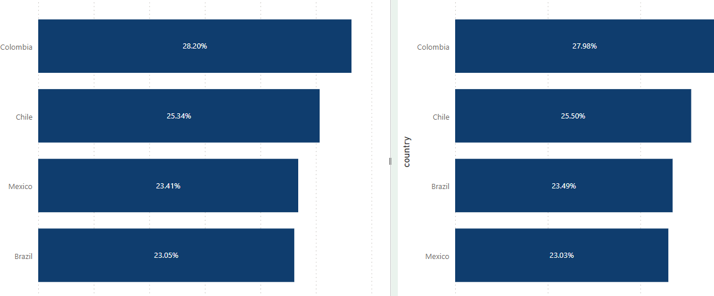
Driving Growth Across Latin America: A Regional Performance Snapshot
Colombia:
Revenue Percentage: 28.20%
Profit Percentage: 27.98%
Colombia emerges as a standout performer, boasting the highest revenue percentage of 28.20% and an impressive profit percentage of 27.98%. Our strategic initiatives, tailored to the unique needs and preferences of Colombian consumers, have resonated strongly, driving both top-line growth and bottom-line profitability.

Slide 6
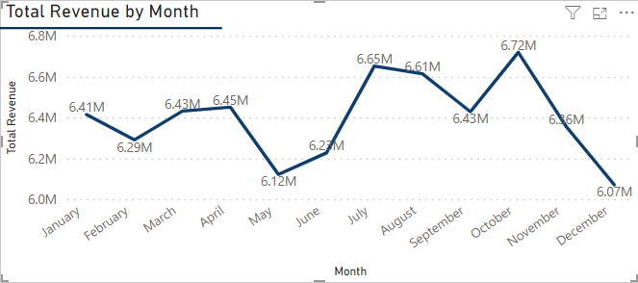
Revenue by month
At 6.72M, October had the highest Total Revenue and was 10.67% higher than December, which had the lowest Total Revenue at 6.07M.

Slide 7
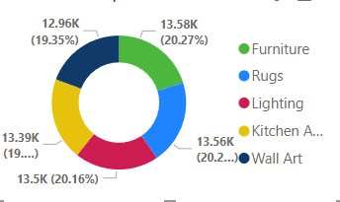
Unveiling Our Profitable Product Categories
Elevate your space with our top-profit furniture (20.27%), rugs (20.24%), lighting (20.16%), kitchen appliances (19.99%), and wall art (19.35%). Explore quality, style, and value for exceptional home décor experiences.

Slide 8
Optimizing Order Fulfillment: Analyzing Shipping Efficiency and Cost
The average time between shipping and order dates is 7.49 days, accompanied by an average shipping cost of 27.51, ensuring timely delivery with affordable shipping charges.

